Slide 1
COMSOL Multiphysics Analysis
Magnetic Braking Systems

Slide 2
Presentation Outline
Introduction to Magnetic Braking
Physics of Eddy Current Braking
COMSOL Multiphysics Overview
Model Setup and Geometry
Physics Interface Configuration
Mesh Generation and Refinement
Solver Settings and Analysis
Results and Validation
Parametric Studies
Optimization Strategies

Slide 3
Introduction to Magnetic Braking

Slide 4
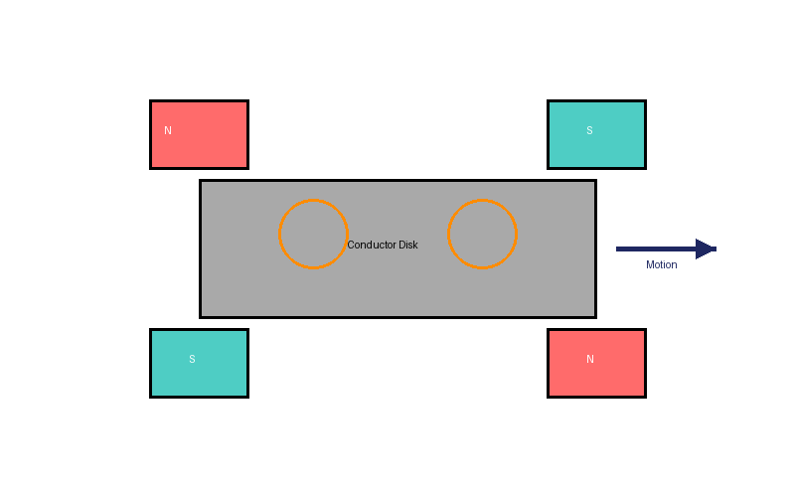
What is Magnetic Braking?
Non-contact braking using electromagnetic forces
Based on electromagnetic induction
No mechanical friction or wear
Applications: trains, roller coasters, instruments
Advantages: smooth, reliable, long lifespan

Slide 5
Types of Magnetic Braking Systems
Eddy Current Brakes:
• Permanent magnet based
• Electromagnet based
• Linear and rotary configurations
Electromagnetic Brakes:
• Spring-applied
• Permanent magnet
• Hysteresis brakes
• Particle brakes

Slide 6
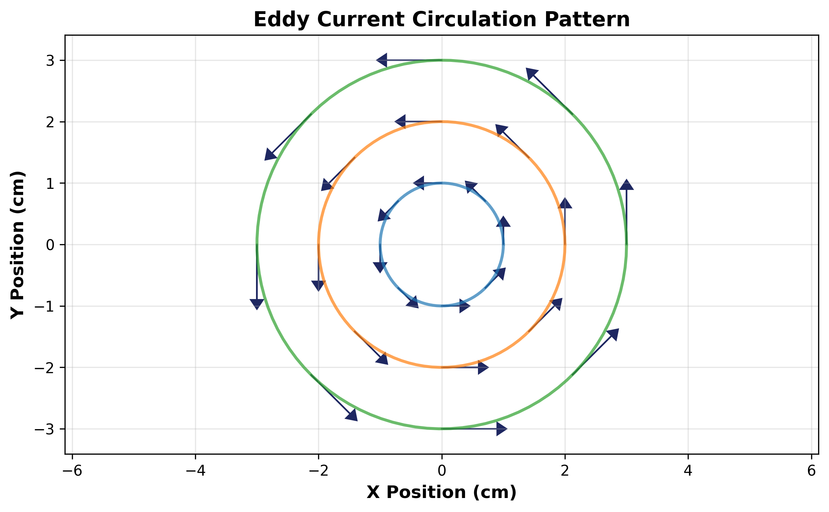
Working Principle
Moving conductor induces eddy currents
Eddy currents create opposing field (Lenz's Law)
Interaction produces braking force
Kinetic energy → thermal energy
Force proportional to velocity and field strength

Slide 7
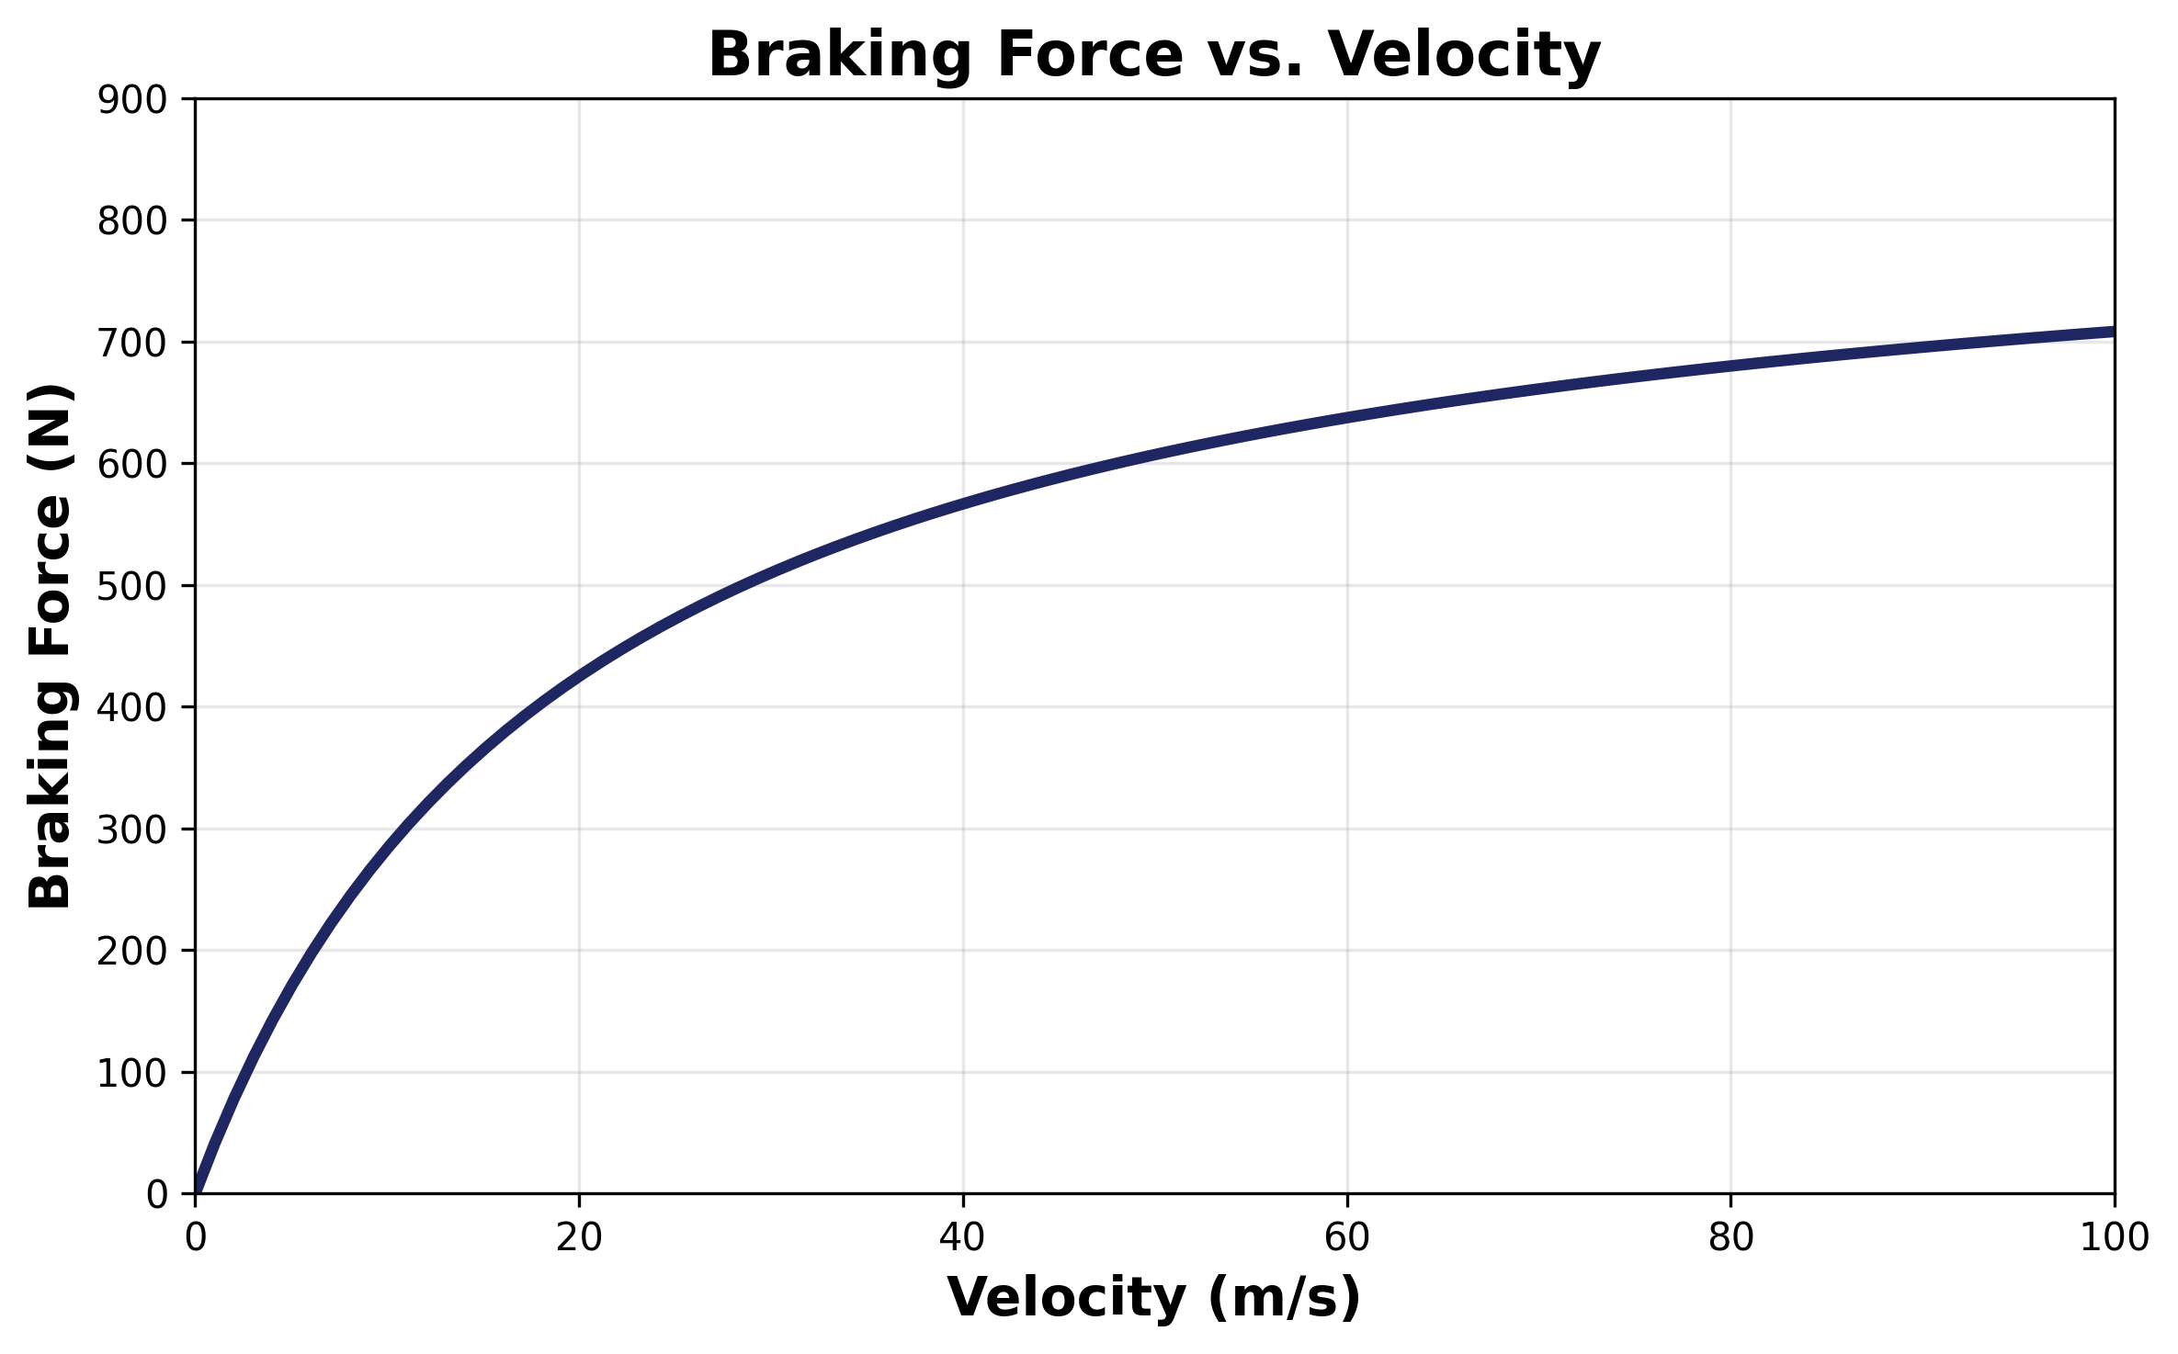
Braking Force vs. Velocity Characteristics

Slide 8
Physics of Eddy Current Braking

Slide 9
Governing Equations
Maxwell's Equations govern electromagnetic behavior
Faraday's Law: ∇ × E = -∂B/∂t
Ampère's Law: ∇ × H = J + ∂D/∂t
Ohm's Law for moving conductors: J = σ(E + v × B)
Lorentz force density: F = J × B

Slide 10
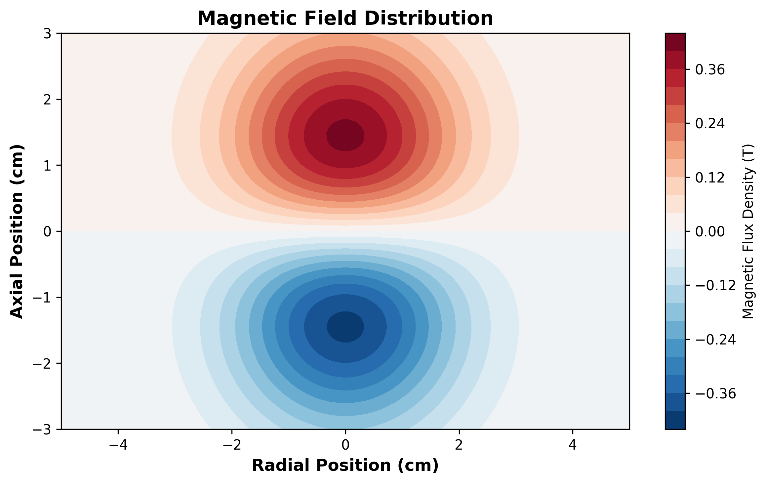
Magnetic Field Distribution

Slide 11
Key Material Properties
Conductor Properties:
• Electrical conductivity (σ)
• Relative permeability (μr)
• Density and heat capacity
• Temperature coefficients
Magnet Properties:
• Remanent flux density (Br)
• Coercivity (Hc)
• Temperature stability
• Energy product (BHmax)

Slide 12
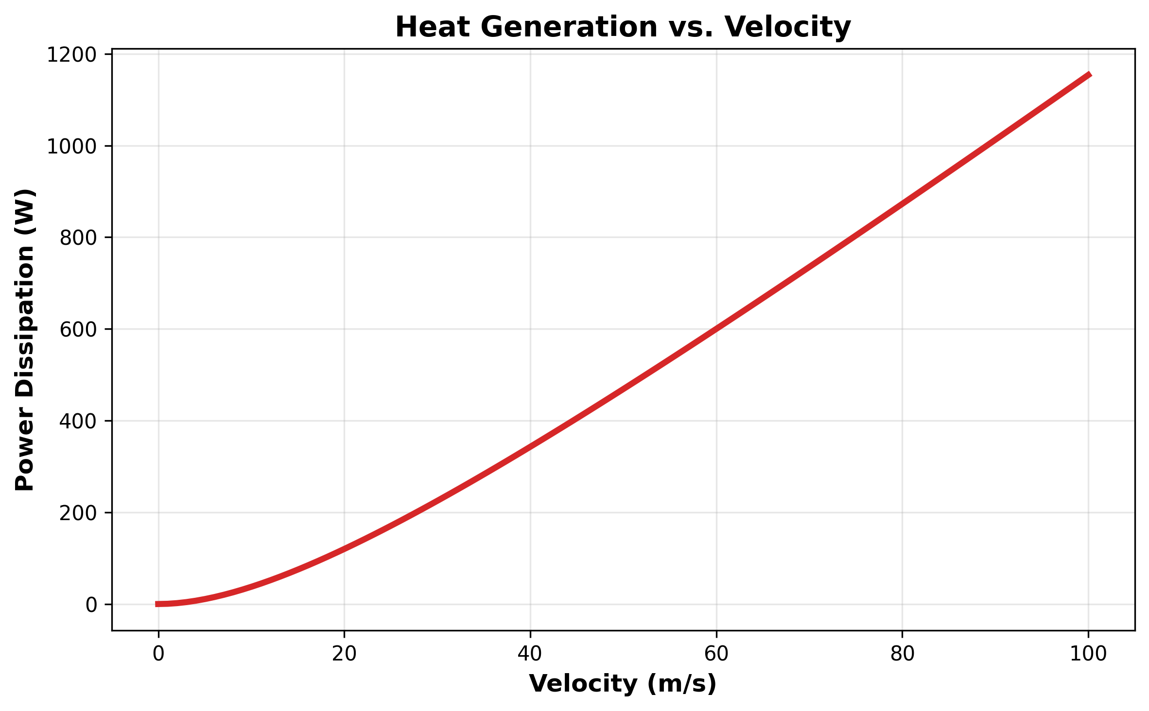
Heat Generation and Dissipation
Joule heating: Q = J²/σ = σ|E + v × B|²
Power depends on velocity and field
Thermal management critical
Heat transfer: conduction, convection, radiation
Temperature affects material properties

Slide 13
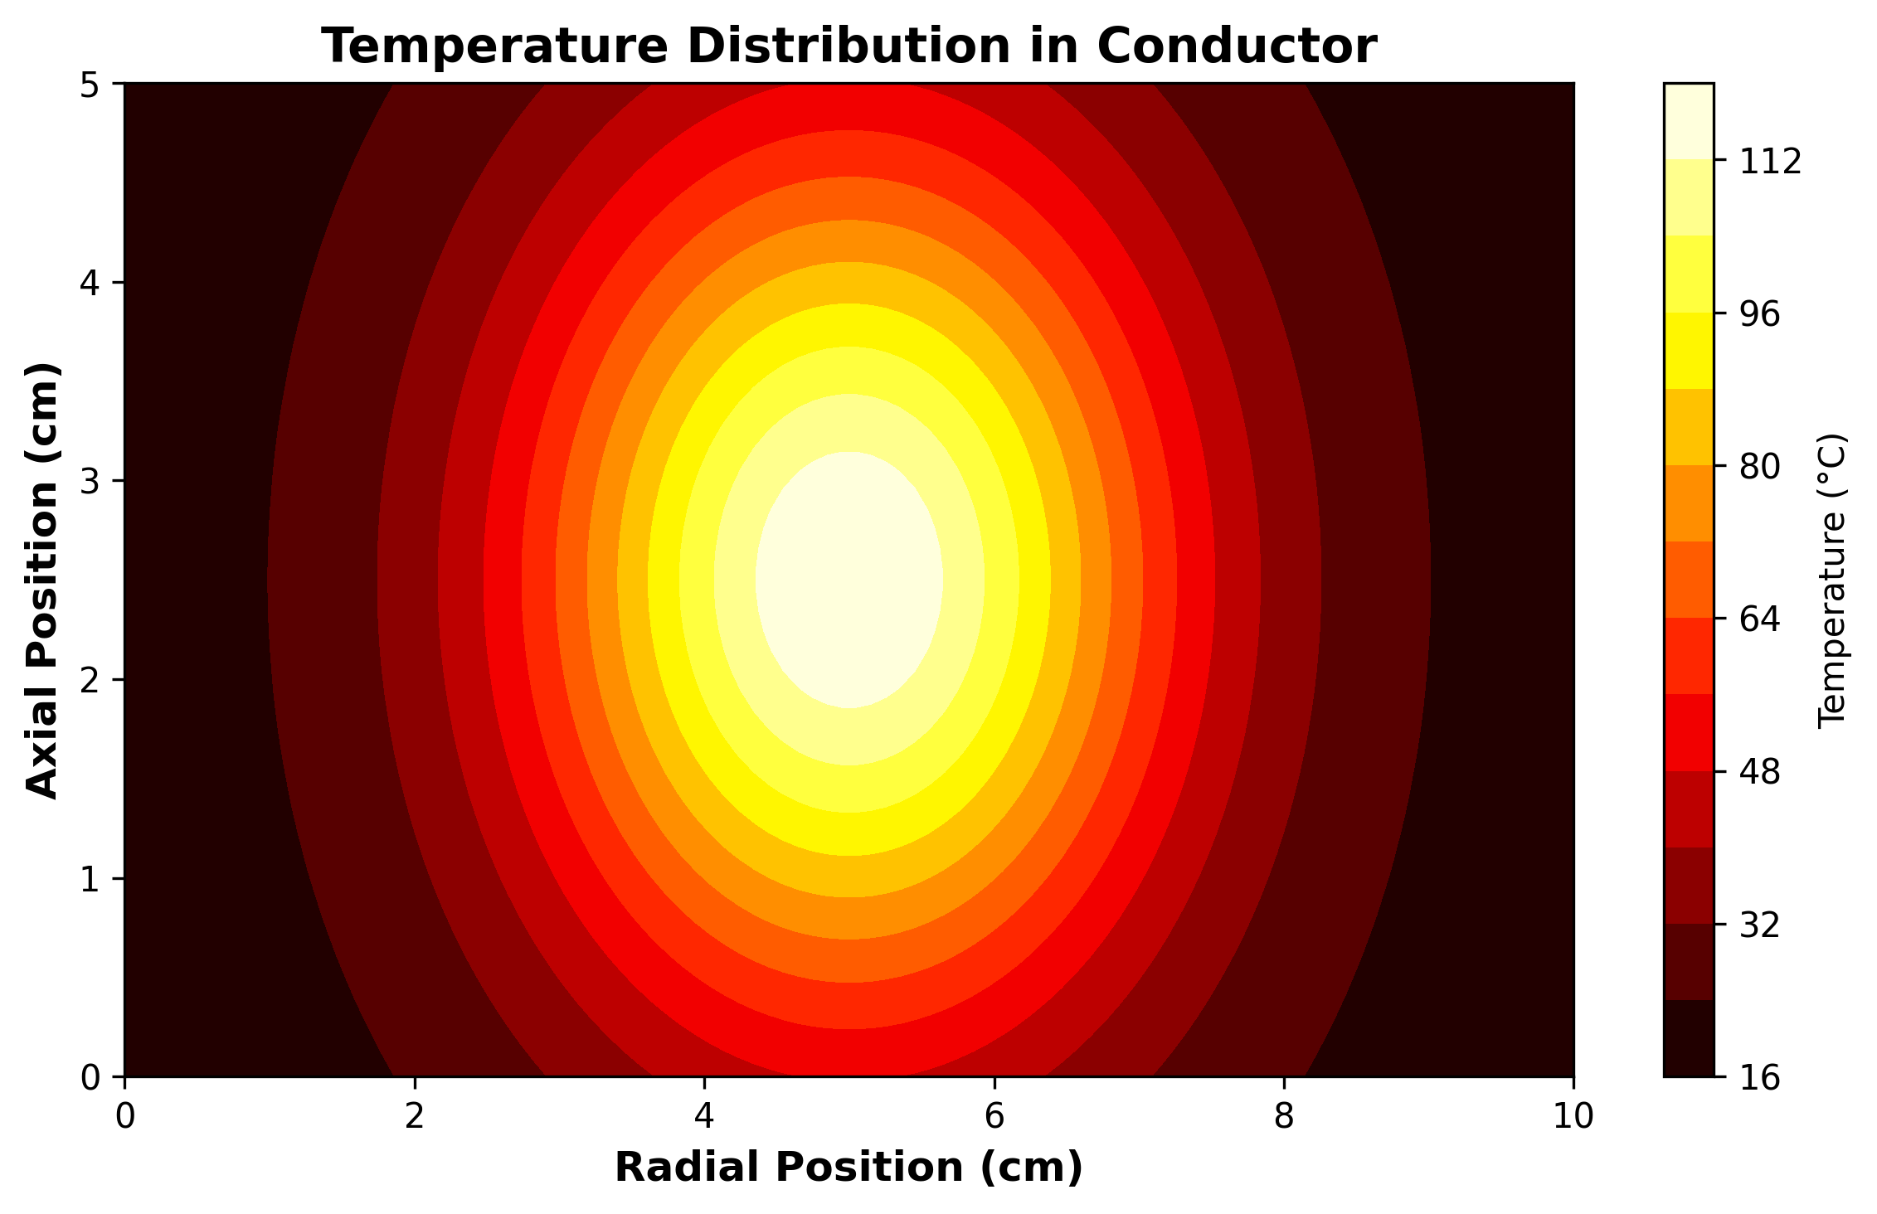
Temperature Distribution in Conductor

Slide 14
COMSOL Multiphysics Modeling

Slide 15
Why COMSOL Multiphysics?
Comprehensive finite element analysis platform
Coupled multiphysics capabilities (EM + thermal)
Built-in physics interfaces for magnetic fields
Parametric modeling and optimization tools
Advanced mesh generation and solver options
Extensive material library and custom properties

Slide 16
Geometry Definition
Create 3D or 2D axisymmetric geometry
Define conductor disk/plate dimensions
Position permanent magnets or electromagnets
Include air domain for field calculations
Add thermal masses and heat sinks if needed
Use symmetry to reduce computational cost

Slide 17
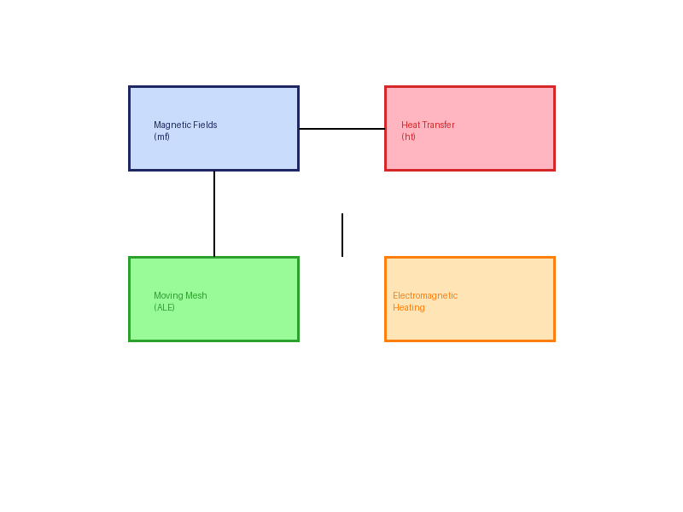
Physics Interface Selection
Magnetic Fields (mf) - primary interface
Heat Transfer in Solids (ht)
Moving Mesh (ALE) for motion
Electromagnetic Heating coupling
Temperature-dependent materials
Velocity coupling between domains

Slide 18
Magnetic Fields Configuration
Select frequency domain or time-dependent study
Define magnetic flux conservation equations
Set boundary conditions: magnetic insulation, symmetry
Specify permanent magnet properties (Br, Hc)
Configure conductor material (σ, μr)
Add velocity for moving conductor analysis

Slide 19
Boundary and Initial Conditions
Magnetic Boundaries:
• Magnetic insulation (n×A=0)
• Symmetry planes
• Perfect magnetic conductor
• Infinite element domain
Initial Conditions:
• Zero initial fields
• Prescribed velocity
• Initial temperature
• Magnet remanence direction

Slide 20
Mesh Generation Strategy

Slide 21
Meshing Considerations
Fine mesh in high-gradient regions (near magnets)
Boundary layer mesh at conductor surface
Coarser mesh in far-field air domain
Mesh refinement based on skin depth: δ = √(2/ωμσ)
At least 3-5 elements across skin depth
Use swept mesh for 3D where possible

Slide 22
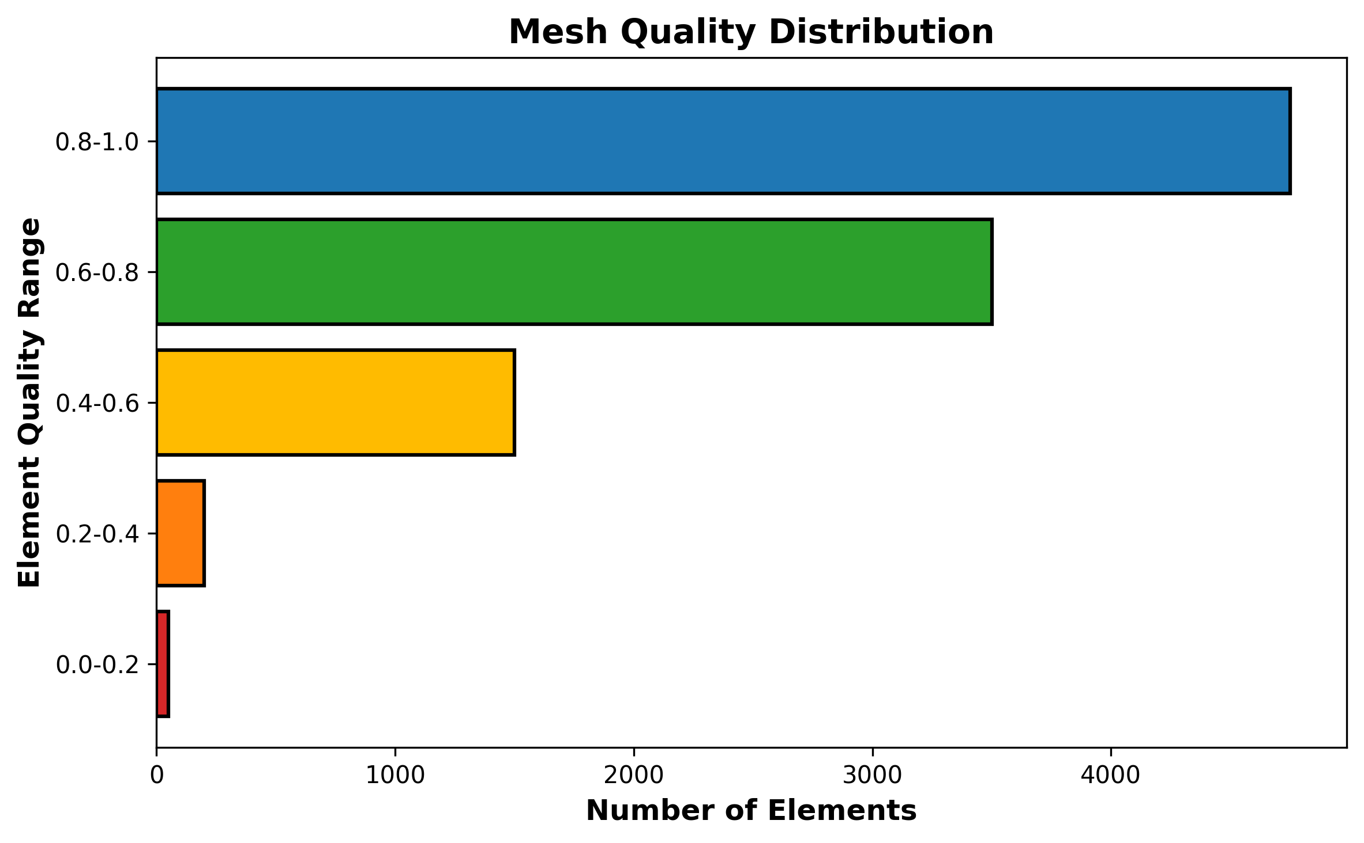
Mesh Quality Metrics
Element quality > 0.3 for tetrahedra
Skewness < 0.85 for good convergence
Growth rate < 1.3 between elements
Check statistics before solving
Verify resolution in critical areas
Perform mesh independence study

Slide 23
Solver Configuration

Slide 24
Study Configuration
Stationary Analysis:
• Fixed velocity simulation
• Steady-state magnetic field
• Thermal steady state
• Parametric velocity sweep
Time-Dependent:
• Transient braking response
• Dynamic velocity profiles
• Thermal transients
• Acceleration/deceleration

Slide 25
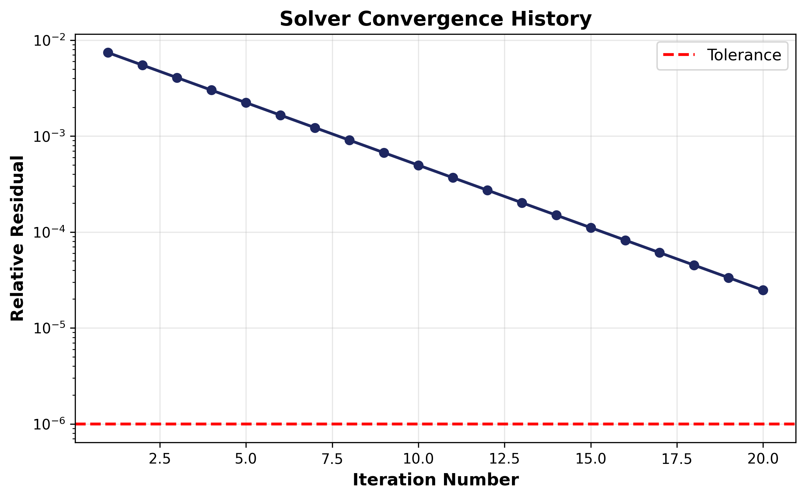
Solver Configuration
Direct solver (MUMPS, PARDISO) for small models
Iterative solvers (GMRES) for large 3D
Relative tolerance: 1e-6 (EM), 1e-4 (thermal)
Segregated solver for multiphysics
Automatic or manual time stepping
Monitor convergence plots

Slide 26
Results and Validation

Slide 27
Electromagnetic Field Analysis
Magnetic flux density (B) distribution
Eddy current density (J) in conductor
Induced electric field patterns
Lorentz force distribution and magnitude
Braking torque or force calculation
Comparison with analytical solutions

Slide 28
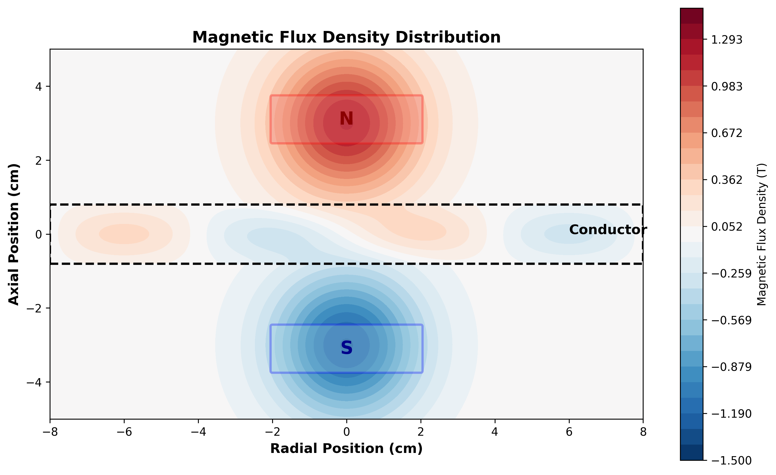
Magnetic Flux Density Distribution

Slide 29
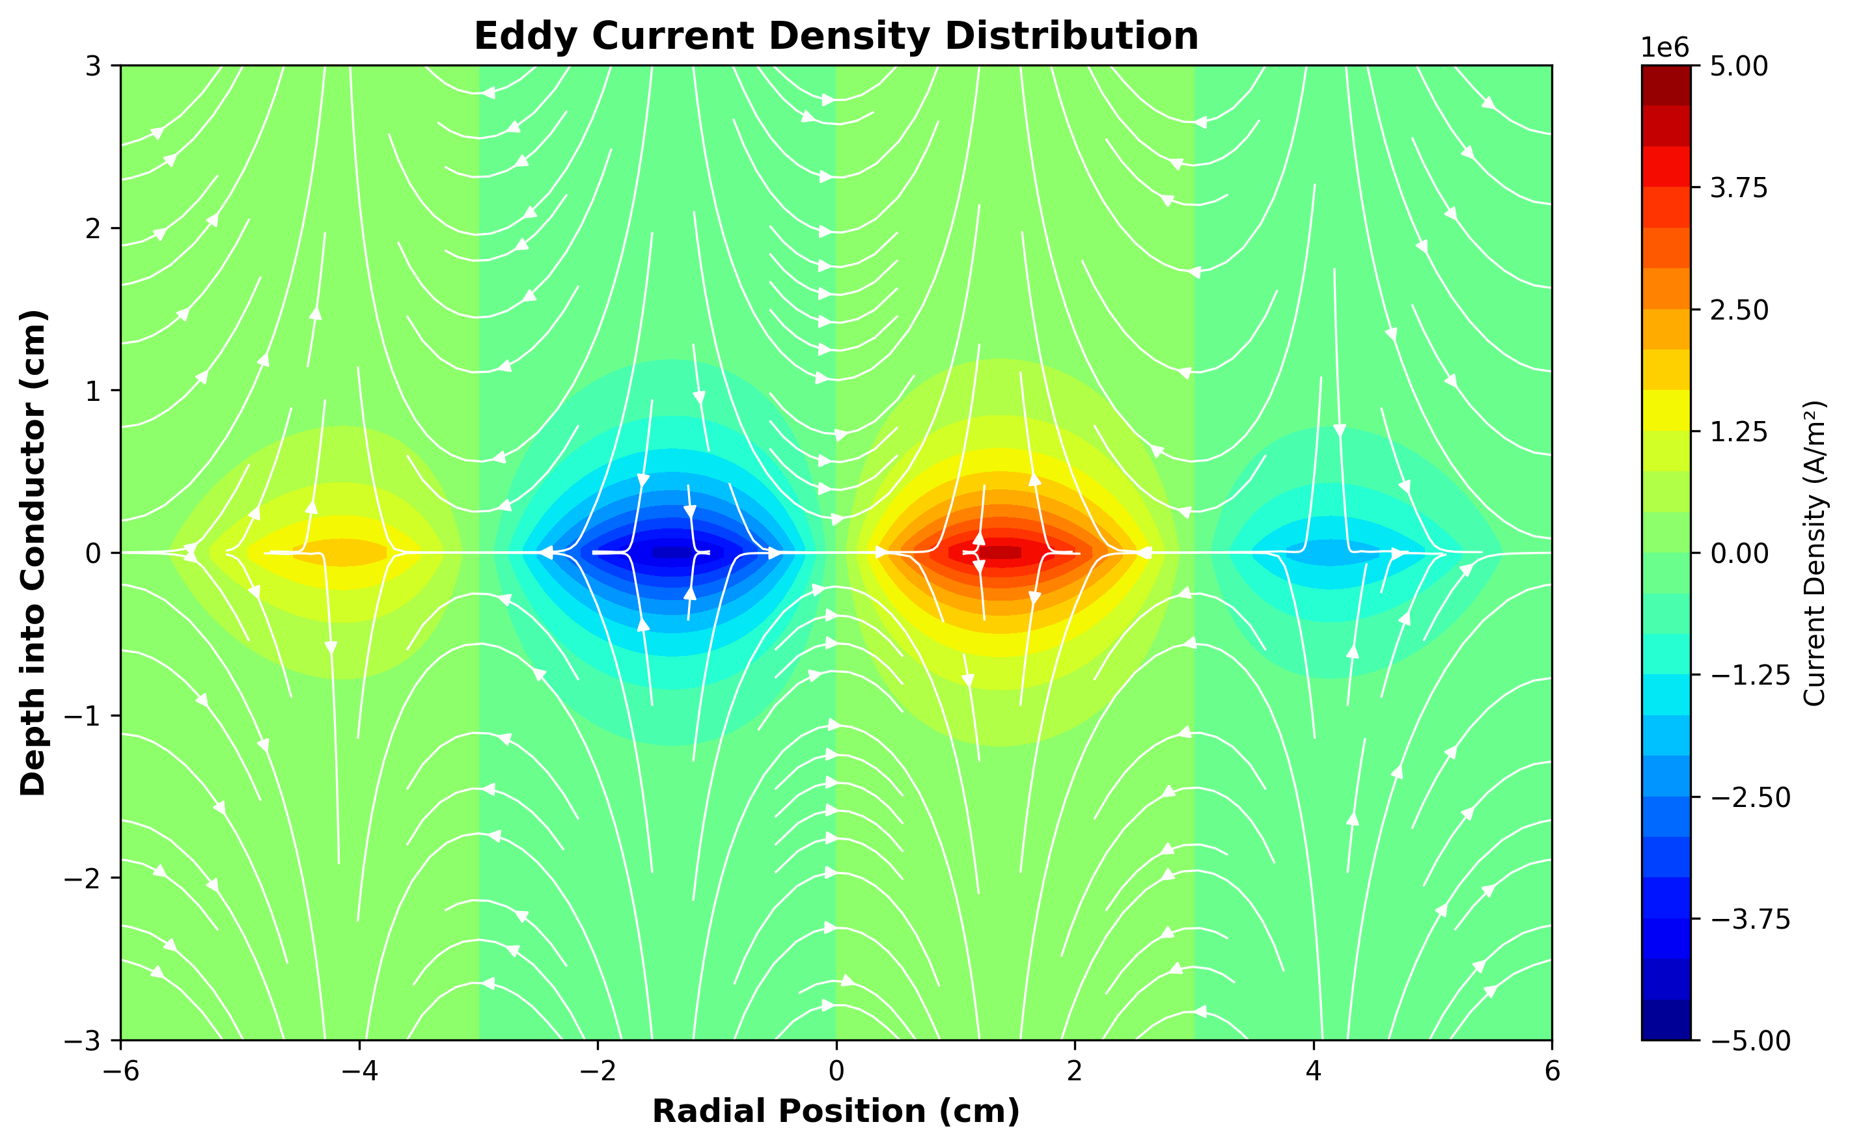
Eddy Current Density Distribution

Slide 30
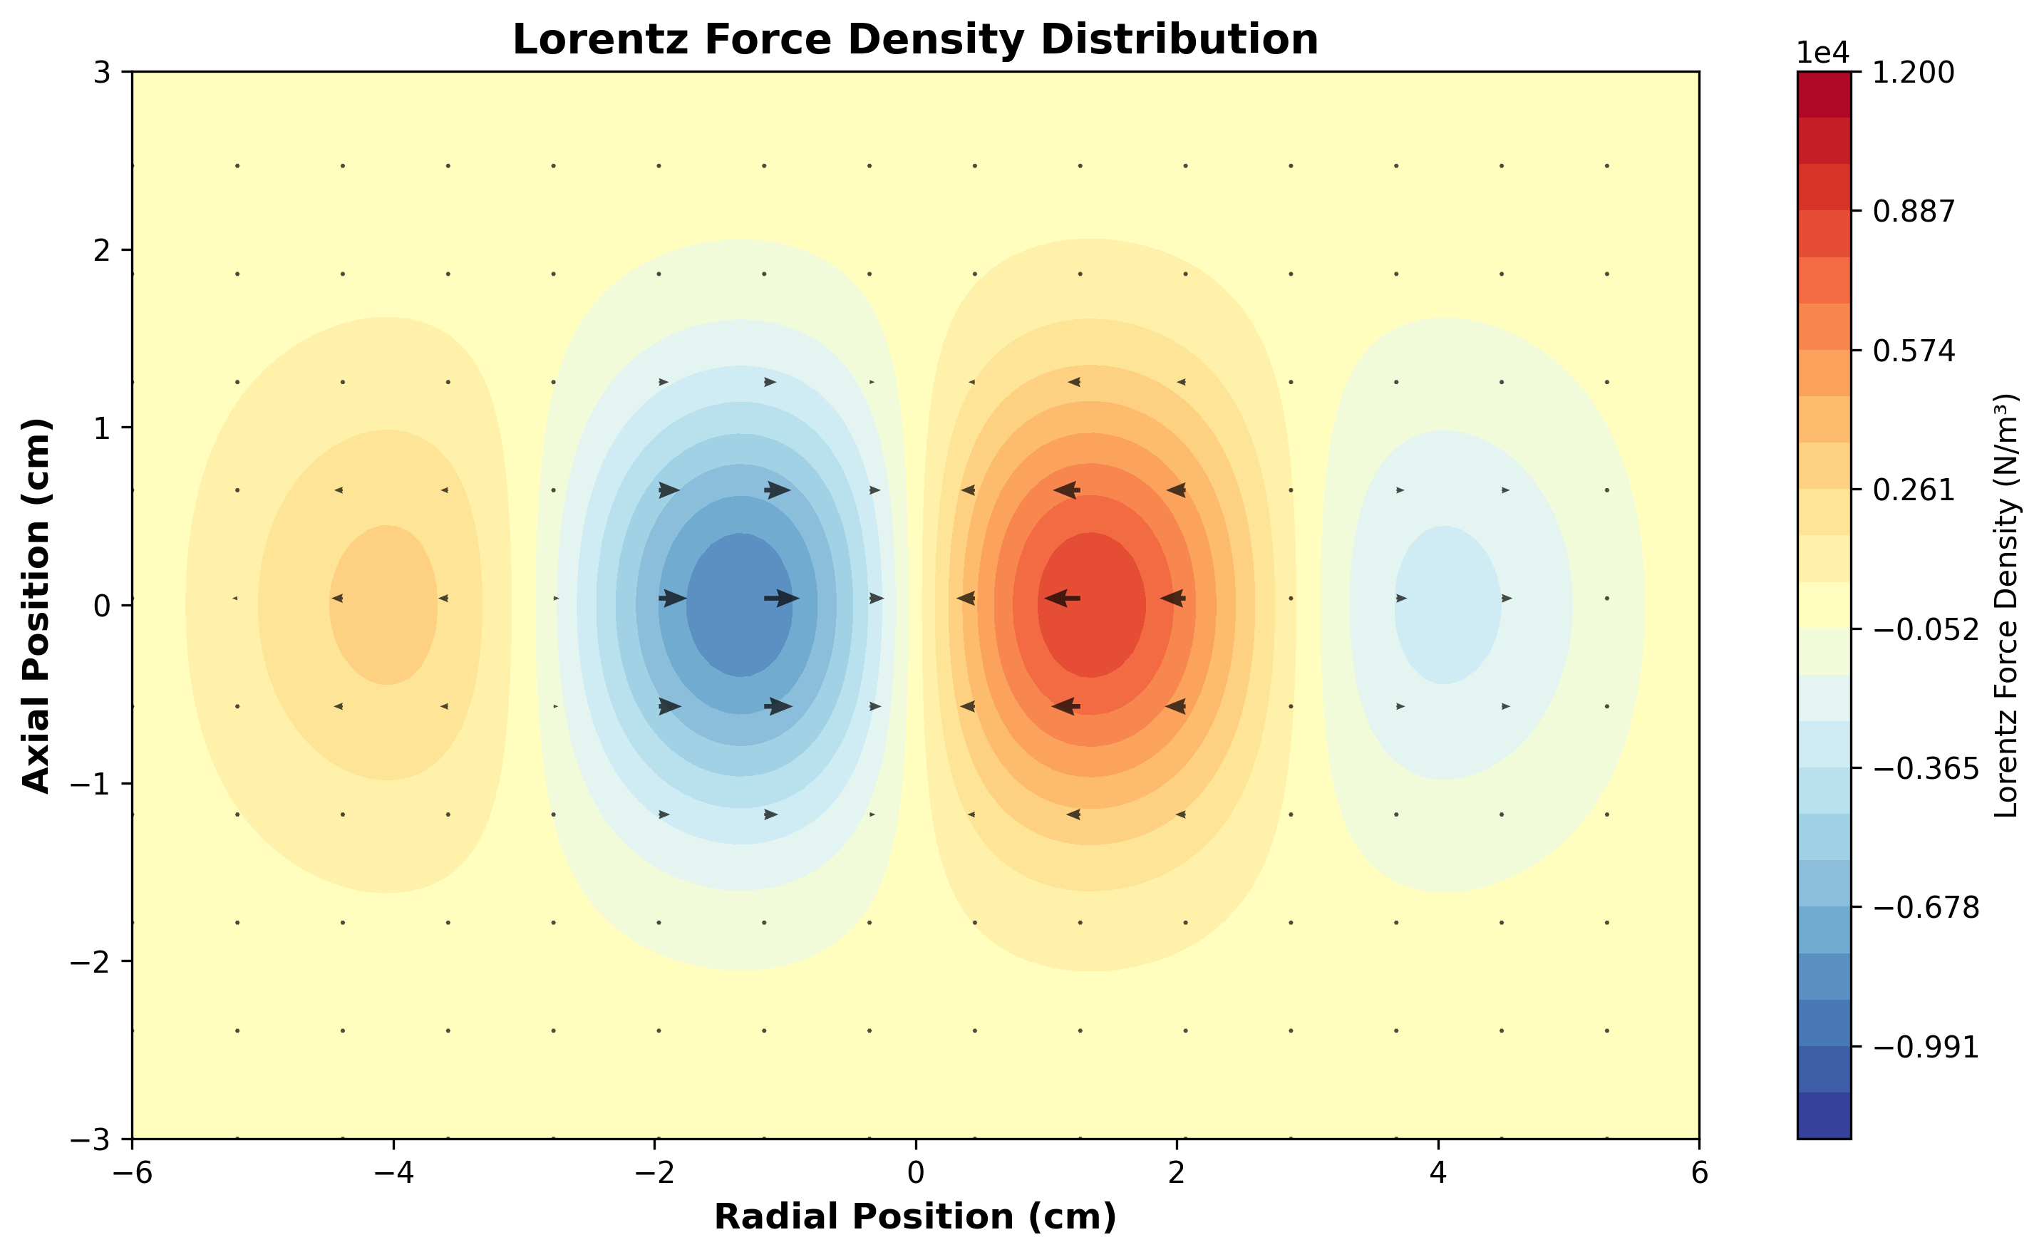
Lorentz Force Density Distribution

Slide 31
Thermal Analysis
Temperature distribution in conductor
Heat generation rate from Joule heating
Thermal gradients and hot spots
Heat flux through boundaries
Thermal stress evaluation if coupled
Cooling system effectiveness

Slide 32
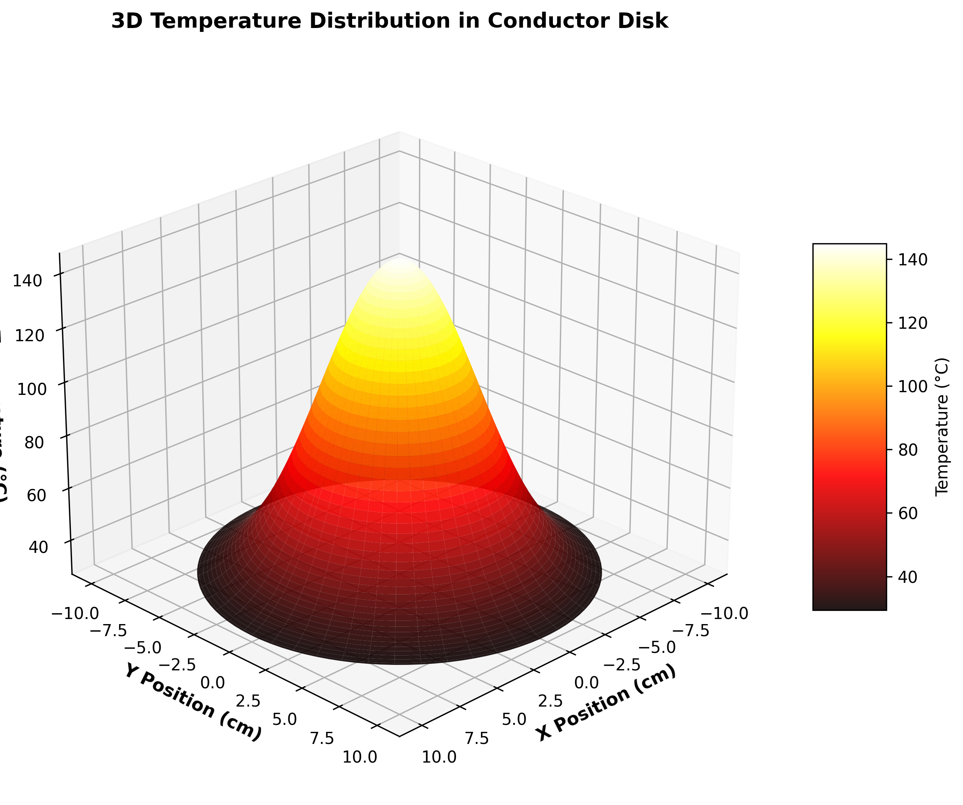
3D Temperature Distribution

Slide 33
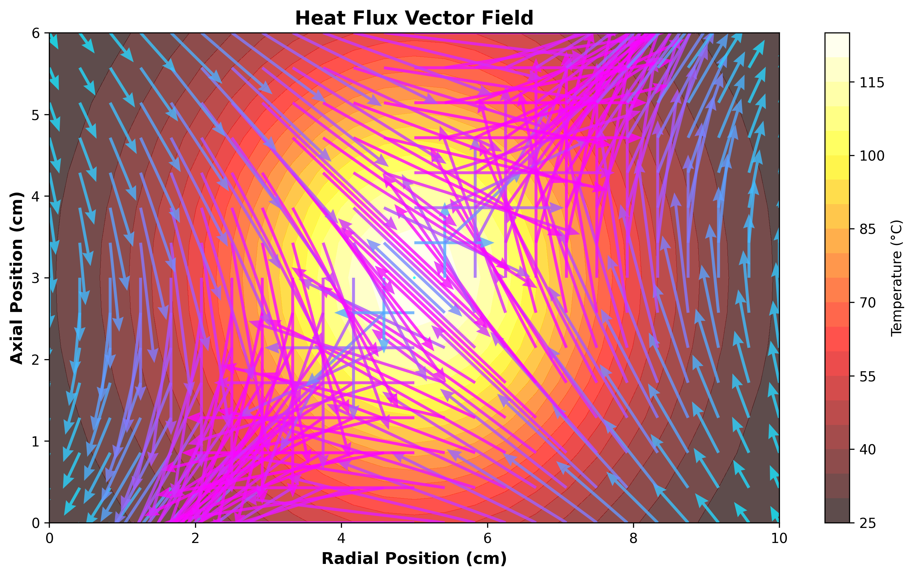
Heat Flux Vector Field

Slide 34
Braking Performance Metrics
Total braking force vs. velocity
Torque output for rotary configurations
Peak braking force and optimal point
Response time and efficiency
Energy dissipation and power losses
Comparison with experimental data

Slide 35
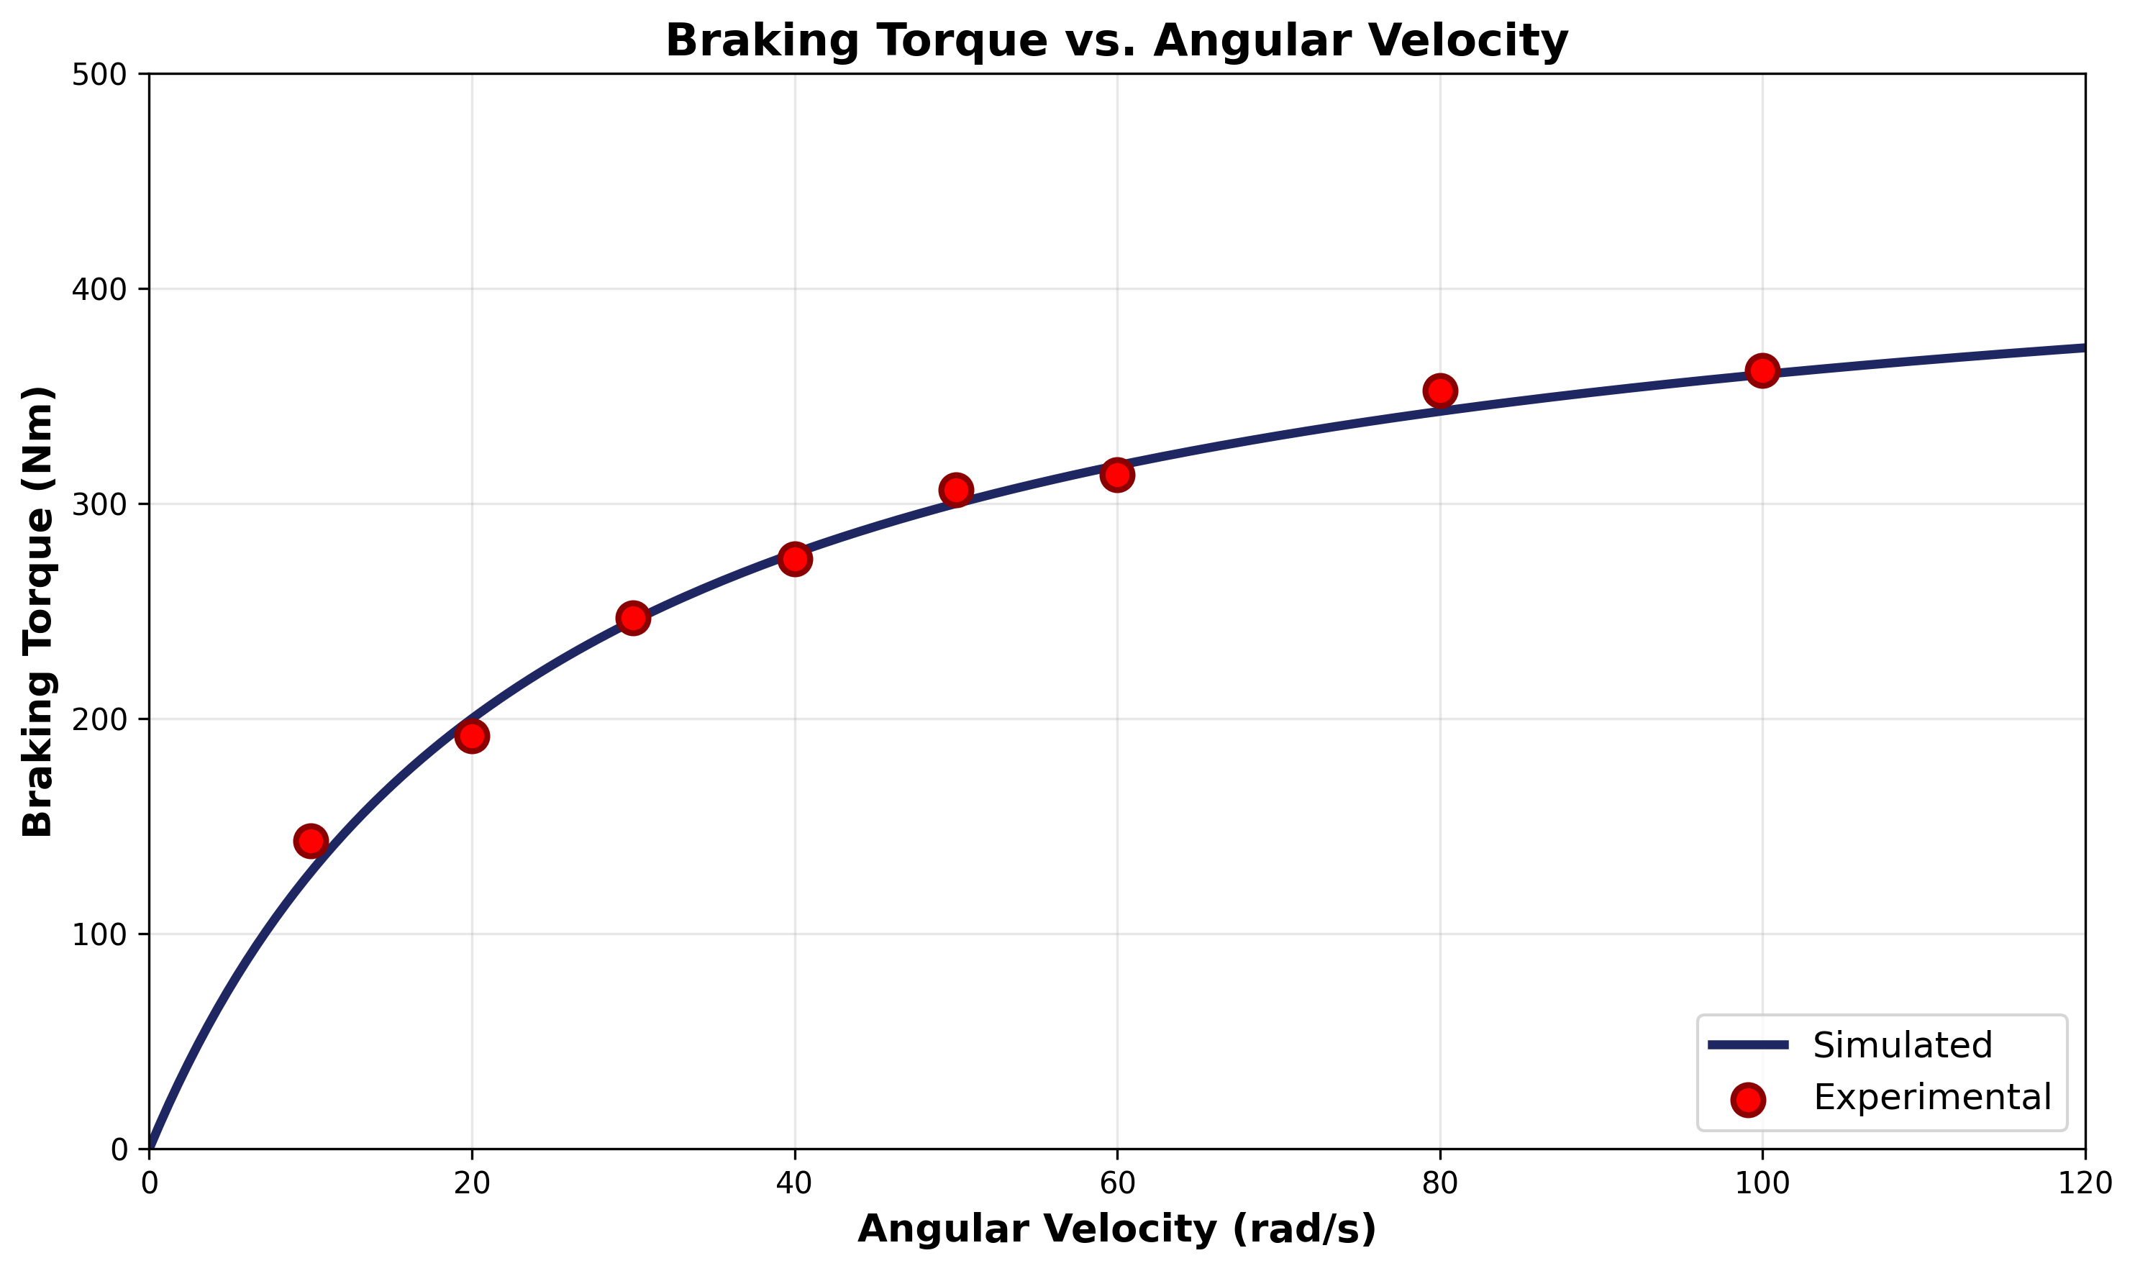
Braking Torque Characteristics

Slide 36
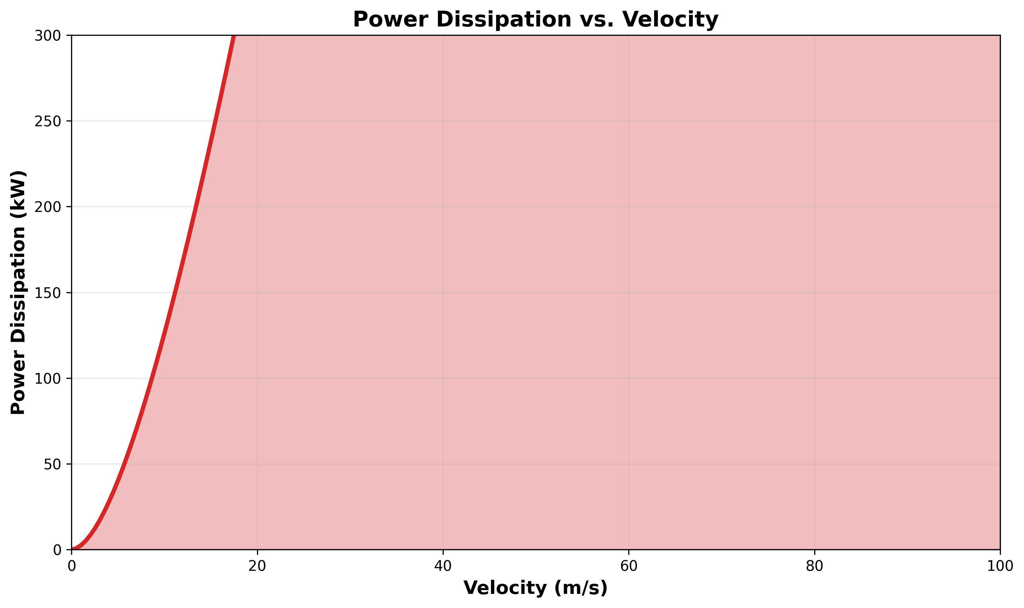
Power Dissipation Analysis

Slide 37
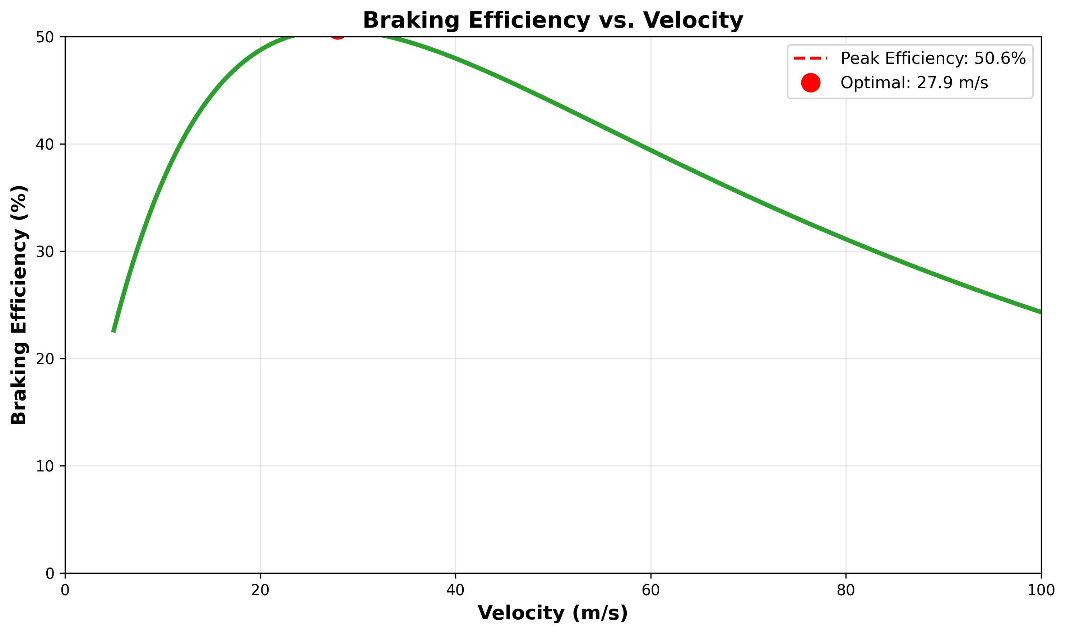
Braking Efficiency Analysis

Slide 38
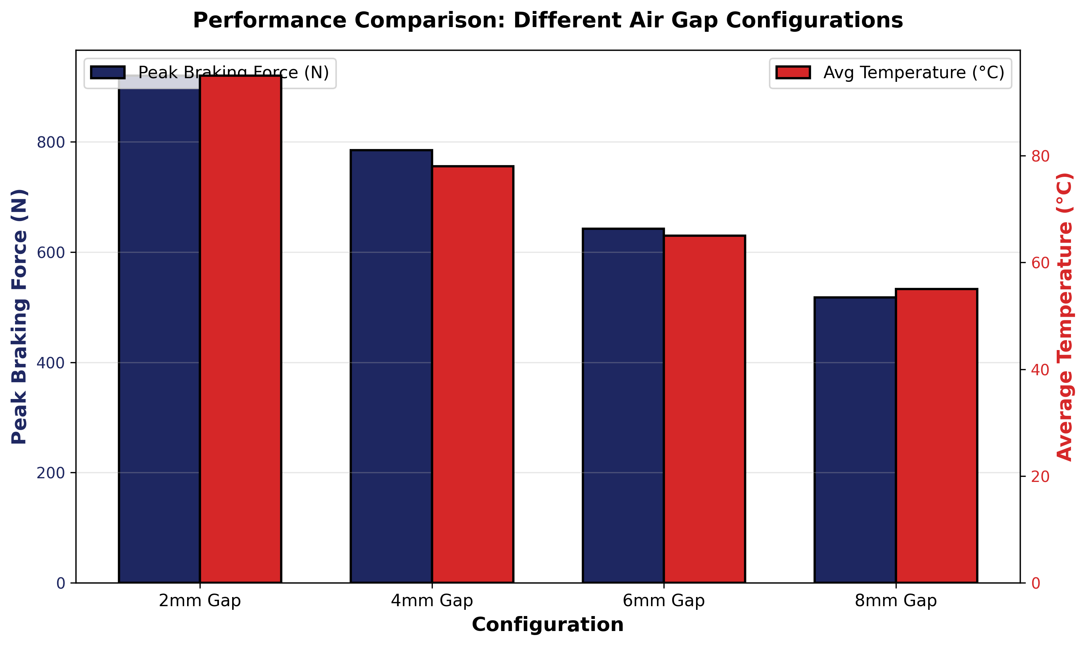
Configuration Performance Comparison

Slide 39
Parametric Analysis

Slide 40
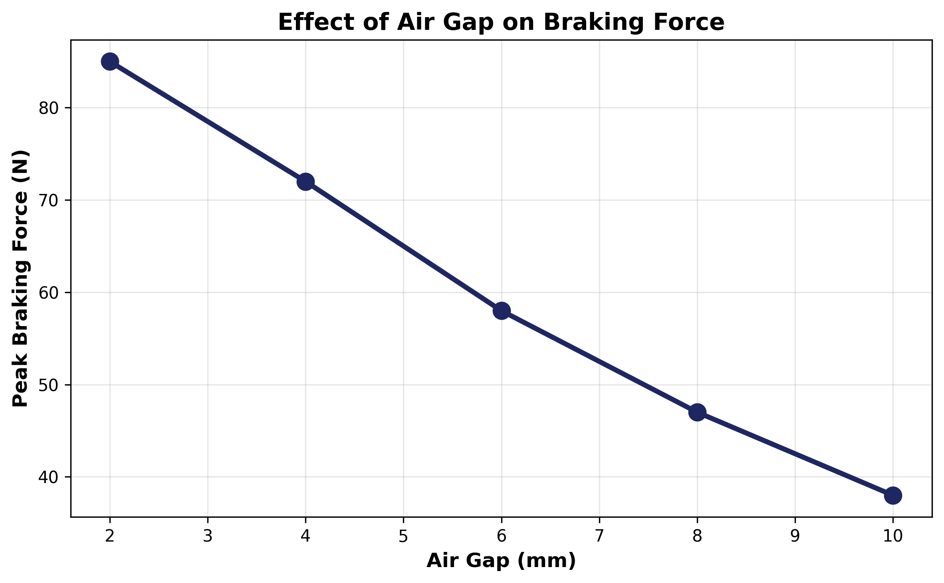
Parametric Study Variables
Conductor thickness and conductivity
Magnet strength and pole configuration
Air gap between magnet and conductor
Velocity range and operating conditions
Geometric parameters (diameter, width)
Temperature effects on performance

Slide 41
Industrial Applications
High-speed rail magnetic braking systems
Roller coaster and amusement ride brakes
Wind turbine emergency braking
Precision positioning systems
Electric vehicle regenerative braking
Industrial machinery and automation
Aerospace and defense applications

Slide 42
Key Takeaways
COMSOL enables comprehensive magnetic braking analysis
Coupled electromagnetic-thermal simulations critical
Proper meshing essential for accurate predictions
Parametric studies guide optimal design
Validation against experiments ensures fidelity
Multiphysics approach reveals complex interactions
Optimization tools enable performance maximization

Slide 43
Thank You

